Slide 1
Slave Bot
Point specific commands

Slide 2
Problem definition
Maneuver the bot using human gestures, which are read by kinect.
User can pinpoint the location of the bot’s destination.
  Note: This is relative to the user.(For example: the user when points to location on the floor which is 80cm away and 30° clockwise from the direction towards kinect, the bot rotates by 30° to the right and then traverses 80cm forward).
Multiple commands issued before being carried out by the bot.
Bot back-tracks to the initial position.

Slide 3
Motivation
KINECT KINECT KINECT!!
  What is more thrilling than working on a gaming console
  (though kinect being an accessory).
Repose!!
  What is more relaxing than getting job done lazing oneself on a couch.
Given a bot and kinect, we planned to maneuver the bot using gestures.

Slide 4
Requirements
Hardware
      Spark-V
      Two ZigBee modules
      Wireless Camera, Receiver and TV Tuner
      Kinect
Software
  The software is a windows based application. The software requires .Net4 Framework, Zigbee FT232R USB UART driver, Kinect Software and Camera Drivers.
      .Net Framework
      Zigbee FT232R USB UART Driver:
      Kinect SDK :
      Camera Devices drivers:

Slide 5
assumptions
No obstacle on the path which the bot travels.
Bot positioned with-in the range of Zigbee
Specified point with a predefined range.

Slide 6

User Commands
Forward
Stop
Left Rotate 45º
Right Rotate 45º
Pinpoint location on ground
Commence executing the commands

Slide 7
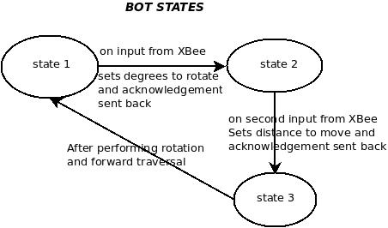
Bot State diagram

Slide 8
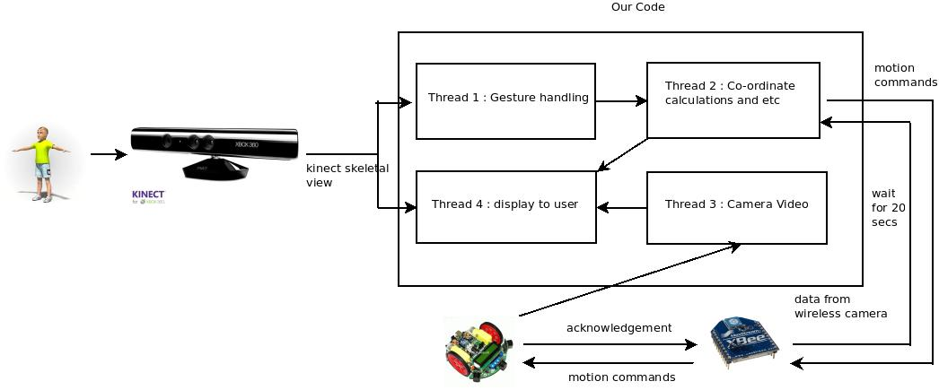
Environment interaction

Slide 9
Algorithm
Thread 1:
  Get the gesture from the Kinect Software.
  Push the relevant information onto the stack
Thread 3:
  Grab the video frames being received and store them in a buffer
Thread 2:
  Get the co-ordinates from the stack information.
  Calculate the angular and radial movements.
  Signal the bot with these gestures implementing Stop and Wait protocol.
Thread 4:
  Display the co-ordinates that are being currently executed and the co-ordinate stack contents.
  Stream the video frames.

Slide 10
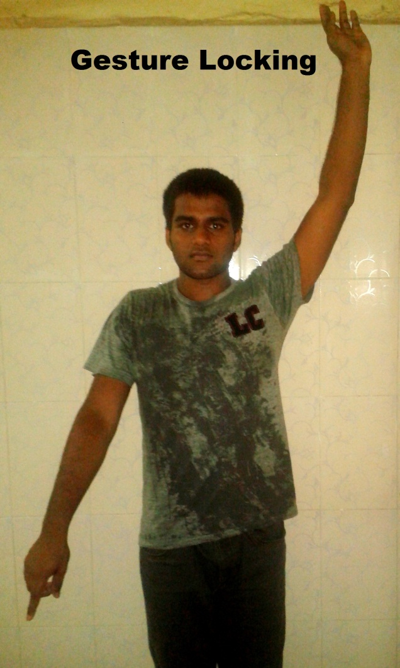
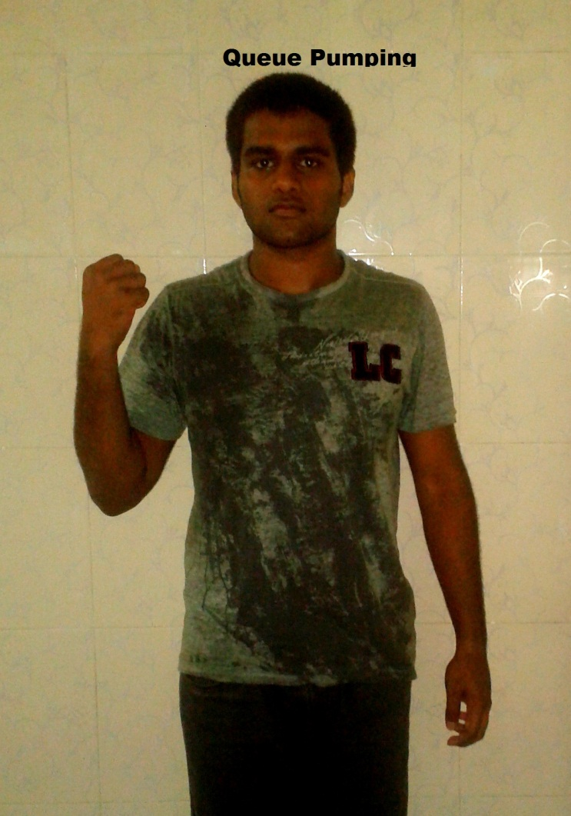
Various gestures

Slide 11
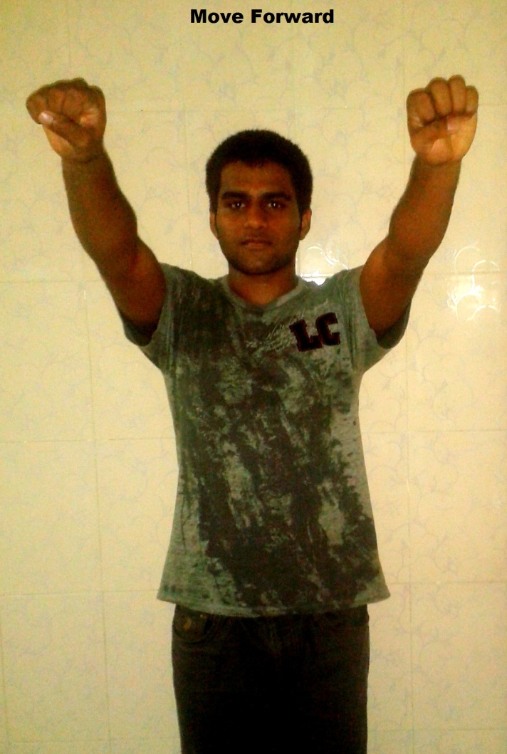
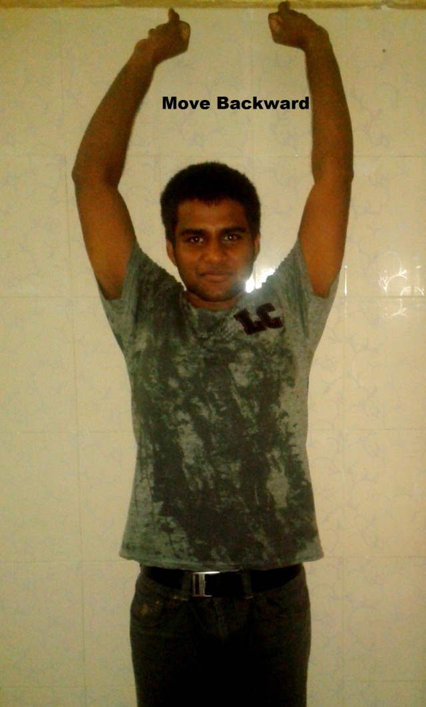
Various gestures

Slide 12
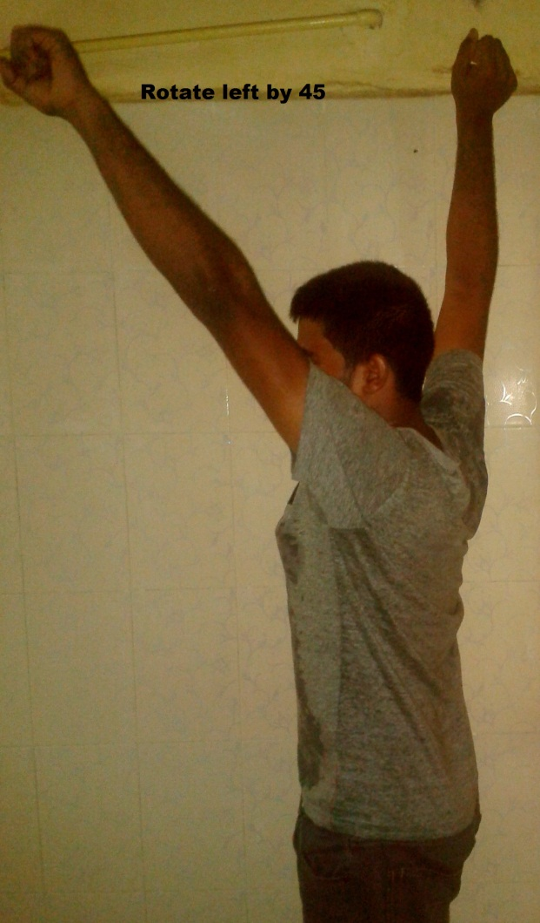
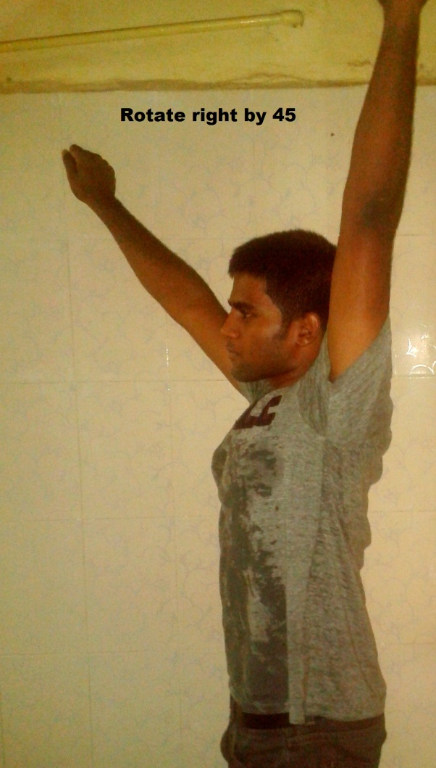
Various gestures

Slide 13
CHALLENGES
Algorithm Design
Thread Synchronization
Stop and Wait Synchronization
Error propagation minimization
Constraint on magnitude of values sent through zigbee

Slide 14
Future Scope
1. The mobilization part is developed in a thread environment, making it possible for any other projects to be confident regarding the mobilization part.
2. Obstacle Avoidance is a very important add-on to the project.
3. The algorithms can be further optimized and threading system can be further developed for a better scalable application.

